Slide 1

Learning Objectives
Define the difference between data and information
Describe what a database is, the various types of databases, and why they are valuable assets for decision making
Explain the importance of database design
Outline how modern databases evolved from file systems
Identify flaws in file system data management
Outline the main components of the database system
Describe the main functions of a database management system (DBMS)

Slide 2


National Economics University Faculty of Data Science & Artificial Intelligence
Database System Design, Implementation And Management Course – Normalization of Database Tables
Instructor: Duc Minh Vu (FDA – SLSCM Lab)
Email: minhvd [at] neu.edu.vn
12/19/2024
Database System Design, Implementation And Management
2

Slide 3
Learning Objectives
6-1 Explain normalization and its role in the database design process
6-2 Identify each of the normal forms: 1NF, 2NF, 3NF, BCNF, 4NF, and 5NF
6-3 Explain how normal forms can be transformed from lower normal forms to higher normal forms
6-4 Apply normalization rules to evaluate and correct table structures
6-5 Identify situations that require denormalization to generate information efficiently
6-6 Use a data-modeling checklist to check that the ERD meets a set of minimum requirements

Slide 4
6-1 Database Tables and Normalization

Slide 5
6-1 Database Tables and Normalization
How do you recognize a poor table structure, and how do you produce a good table?
Normalization is a process for evaluating and correcting table structures to minimize data redundancies.
Involve assigning attributes to tables based on the concepts of determination and functional dependency.
Normal forms: first three forms include first normal form (1NF), second normal form (2NF), and third normal form (3NF).
From a structural point of view, 2NF is better than 1NF, and 3NF is better than 2NF.
For most purposes in business database design, 3NF is as high as you need to go in the normalization process

Slide 6
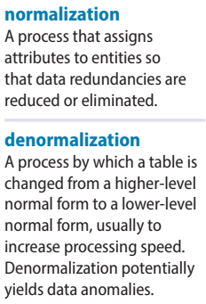
6-1 Database Tables and Normalization
The higher the normal form, the more relational join operations you need to produce a specified output. More resources are required by the database system to respond to end-user queries.
Denormalization produces a lower normal form; that is, a 3NF will be converted to a 2NF through denormalization.
The price you pay for increased performance through denormalization is greater data redundancy

Slide 7
6-2 The Need for Normalization

Slide 8
6-2 The Need for Normalization
Design process
Identifying business rules
Identifying and defining business and data constraints
Defining functional dependencies
Identifying entities and relationships
Eliminating multivalued attributes
Design and normalize
Defining the business rules and data constraints, and identifying the functional dependencies, entities, and attributes
Apply normalization concepts to validate and further refine the model.

Slide 9
Reporting activities of a construction
A construction company that manages several building projects.
Each project has its own project number, name, assigned employees, and so on.
Each employee has an employee number, name, and job classification, such as engineer or computer technician
The company charges its clients by billing the hours spent on each contract.
The hourly billing rate is dependent on the employee’s job classification.
One hour of computer technician time is billed at a different rate than one hour of engineer time.
A project report is generated that contains the information displayed in Table 6.1.

Slide 10
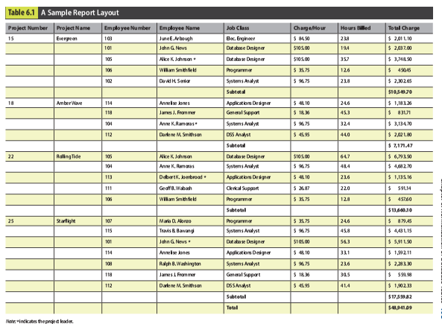

Slide 11
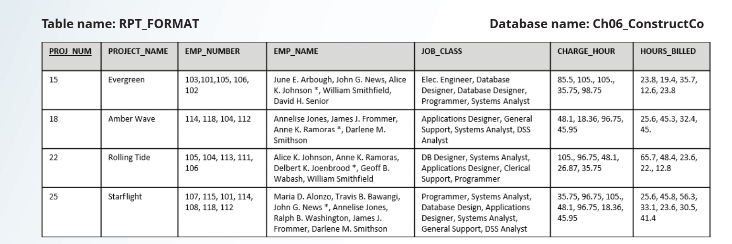
unnormalized data, reflected by the existence of several multivalued data elements (EMP_NUM, EMP_NAME, JOB_CLASS, CHARGE_HOUR, HOURS_BILLED)

Slide 12
Deficiencies
Data inconsistencies.
“Elect. Engineer” might be entered as “Elect.Eng.”, “El. Eng.” and “EE”.
John G. News and Alice K. Johnson in the Evergreen project to charge different rates even though they have the same job classification.
contains several multivalued attributes
hard to identify each employee individually and for the database to answer questions such as “How many employees are working on the Starflight project
Employee data is redundant

Slide 13
6-3 The Normalization Process

Slide 14
6-3 The Normalization Process
Concept of well-formed relations:
Each relation (table) represents a single subject
Each row/column intersection contains only one (a single) value and not a group of values.
No data item will be unnecessarily stored in more than one table
All nonprime attributes in a relation (table) are dependent on the primary key—the entire primary key and nothing but the primary key
Each relation (table) has no insertion, update, or deletion anomalies, which ensures the integrity and consistency of the data.

Slide 15
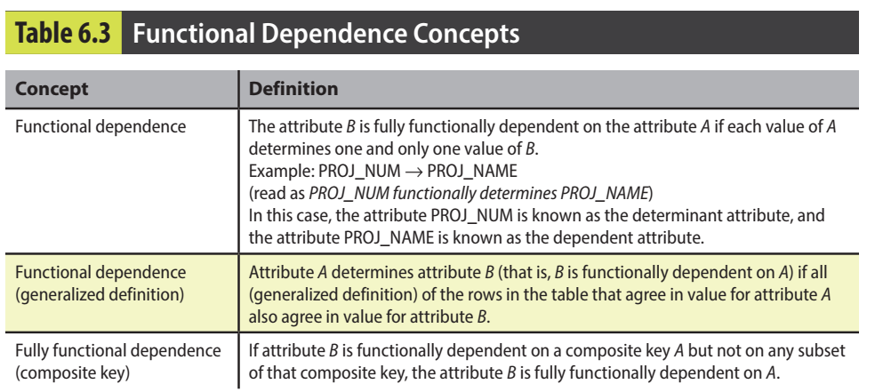

Slide 16
Functional Dependence Concepts
partial dependency: A condition in which an attribute is dependent on only a portion (subset) of the primary key.
If (A, B) → (C, D), B → C, and (A, B) is the primary key, then the functional dependence B → C is a partial dependency because only part of the primary key (B) is needed to determine the value of C.
transitive dependency: A condition in which an attribute is dependent on another attribute that is not part of the primary key
There are functional dependencies such that X → Y, Y → Z, and X is the primary key. In that case, the dependency X → Z is a transitive dependency because X determines the value of Z via Y

Slide 17
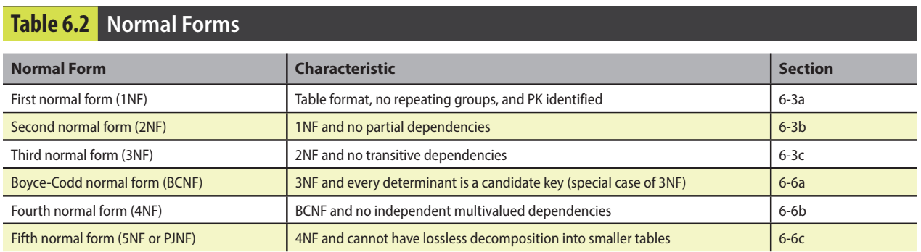

Slide 18
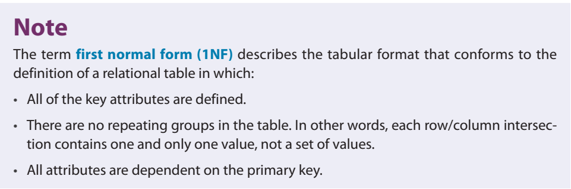

Slide 19
6-3a Conversion to First Normal Form (1NF)
A repeating group derives its name from the fact that a group of multiple entries of the same or multiple types can exist for any single key attribute occurrence.
PROJ_NUM occurrence can reference a group of related data in the employee number, employee name, job classification, and charge per hour columns.
Evergreen project (PROJ_NUM = 15) contains five values for each of those attributes
Eliminate repeating group by making sure that each row defines a single entity instance and that each row-column intersection has only a single value.
The dependencies must be identified to diagnose the normal form.
Normalization starts with a simple three-step procedure

Slide 20
6-3a Conversion to First Normal Form (1NF)
Step 1: Eliminate the Repeating Groups
Start by presenting the data in a tabular format, where each cell has a single value and there are no repeating groups.
To eliminate the repeating groups, change the table from a project focus to an assignment focus.
This will create separate rows for each employee assigned to each project, converting the multivalued attributes into single-valued attributes.
This change converts the table in Figure 6.1 to 1NF as shown in Figure 6.2.

Slide 21
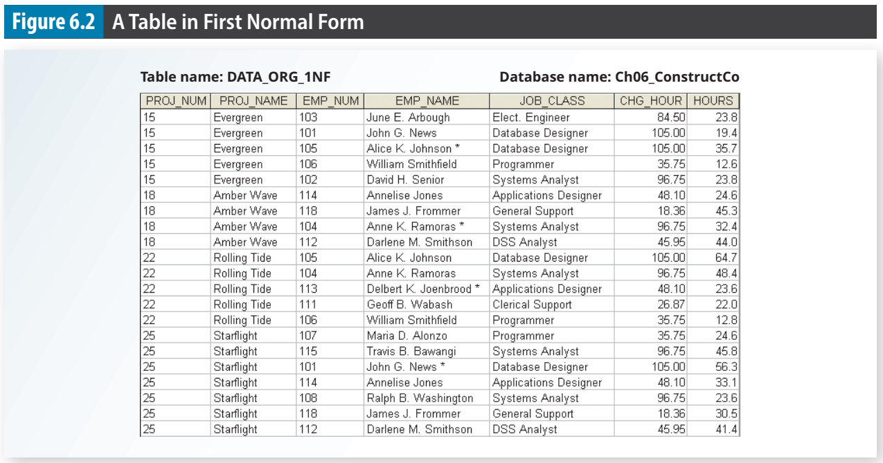

Slide 22
6-3a Conversion to First Normal Form (1NF)
Step 2: Identify the Primary Key
PROJ_NUM is not an adequate primary key because the project number does not uniquely identify each row.
To maintain a proper primary key that will uniquely identify any attribute value, the new key must be composed of a combination of PROJ_NUM and EMP_NUM.
PROJ_NUM = 15 and EMP_NUM = 103, the entries for the attributes PROJ_NAME, EMP_NAME, JOB_CLASS, CHG_HOUR, and HOURS must be Evergreen, June E. Arbough, Elect. Engineer, $84.50, and 23.8, respectively.

Slide 23
6-3a Conversion to First Normal Form (1NF)
Step 3: Identify All Dependencies
The identification of the PK in Step 2 means that you have already identified the following dependency: PROJ_NUM, EMP_NUM → PROJ_NAME, EMP_NAME, JOB_CLASS, CHG_HOUR, HOURS
The PROJ_NAME, EMP_NAME, JOB_CLASS, CHG_HOUR, and HOURS values are all dependent on—they are determined by—the combination of PROJ_NUM and EMP_NUM.

Slide 24
6-3a Conversion to First Normal Form (1NF)
Anomalies remain
Each time another employee is assigned to a project, some data entries (such as PROJ_NAME, EMP_NAME, and CHG_HOUR) are unnecessarily repeated
The anomalies that remain exist because there are additional dependencies in addition to the primary key dependency.
Project number determines the project name: PROJ_NUM → PROJ_NAME
Employee number determines employee’s name, job classification, and charge per hour: EMP_NUM → EMP_NAME, JOB_CLASS, CHG_HOUR

Slide 25
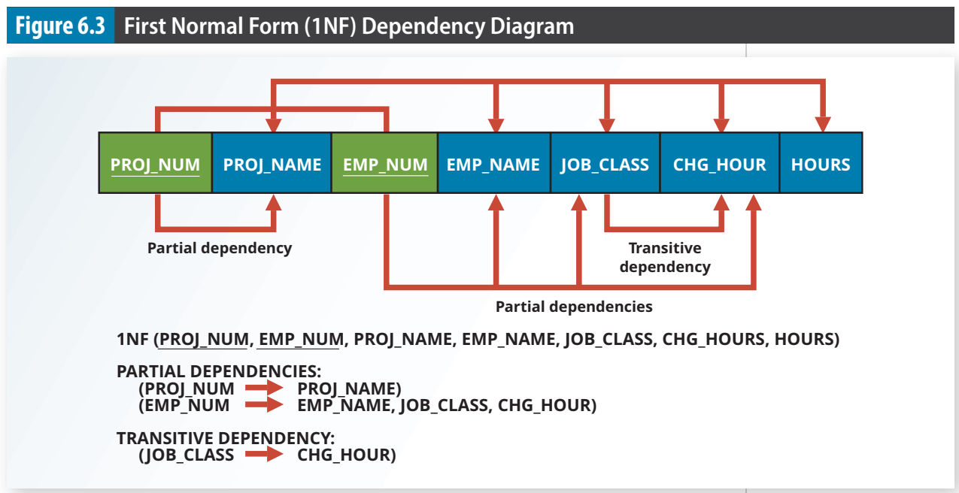
Dependency diagram
A representation of all data dependencies (primary key, partial, or transitive) within a table.

Slide 26
Anomalies
Update anomalies. Modifying the JOB_CLASS for an employee requires updating many entries; otherwise, it will generate data inconsistencies.
Insertion anomalies. Adding a new employee requires the employee to be assigned to a project and therefore to enter duplicate project information. If the employee is not yet assigned to a project, a phantom project must be created to complete the employee data entry.
Deletion anomalies. Suppose that only one employee is associated with a given project. If that employee is deleted, the project information will also be deleted.

Slide 27
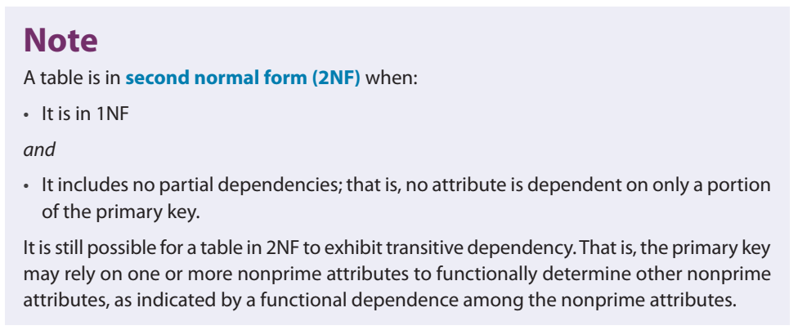
6-3b Conversion to Second Normal Form (2NF)
Conversion to 2NF occurs only when the 1NF has a composite primary key.
.

Slide 28
6-3b Conversion to Second Normal Form (2NF)
Step 1: Make New Tables to Eliminate Partial Dependencies For each component of the primary key that acts as a determinant in a partial dependency, create a new table with a copy of that component as the primary key.
The original table is now divided into three tables (PROJECT, EMPLOYEE, and ASSIGNMENT).
Step 2: Reassign Corresponding Dependent Attributes
PROJECT (PROJ_NUM, PROJ_NAME) EMPLOYEE (EMP_NUM, EMP_NAME, JOB_CLASS, CHG_HOUR) ASSIGNMENT (PROJ_NUM, EMP_NUM, ASSIGN_HOURS)

Slide 29
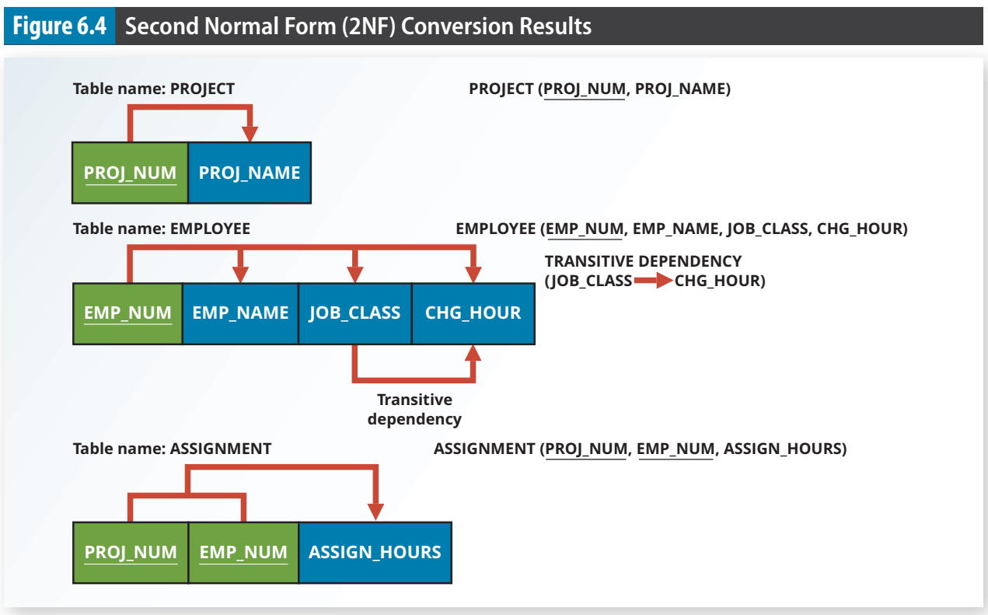

Slide 30
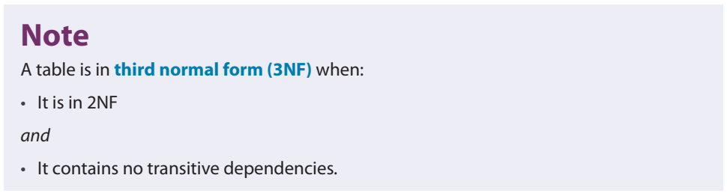
6-3c Conversion to Third Normal Form (3NF)
A transitive dependency can generate anomalies.
third normal form (3NF) A table is in 3NF when it is in 2NF and no nonkey attribute is functionally dependent on another nonkey attribute; that is, it cannot include transitive dependencies.

Slide 31
6-3c Conversion to Third Normal Form (3NF)
Step 1: Make New Tables to Eliminate Transitive Dependencies
For every transitive dependency, write a copy of its determinant (JOB_CLASS) as a primary key for a new table. the determinant remain in the original table to serve as a foreign key
Step 2: Reassign Corresponding Dependent Attributes identify the attributes that are dependent on each determinant identified in Step 1. Place the dependent attributes in the new tables with their determinants and remove them from their original tables.
In this example, eliminate CHG_HOUR from the EMPLOYEE table shown in Figure 6.4 to leave the EMPLOYEE table dependency definition as: EMP_NUM → EMP_NAME, JOB_CLASS

Slide 32
6-3c Conversion to Third Normal Form (3NF)
A transitive dependency can generate anomalies.
Step 1: Make New Tables to Eliminate Transitive Dependencies
For every transitive dependency, write a copy of its determinant (JOB_CLASS) as a primary key for a new table. the determinant remain in the original table to serve as a foreign key
Step 2: Reassign Corresponding Dependent Attributes identify the attributes that are dependent on each determinant identified in Step 1. Place the dependent attributes in the new tables with their determinants and remove them from their original tables.
Eliminate CHG_HOUR from the EMPLOYEE table shown in Figure 6.4 to leave the EMPLOYEE table dependency definition as: EMP_NUM → EMP_NAME, JOB_CLASS

Slide 33
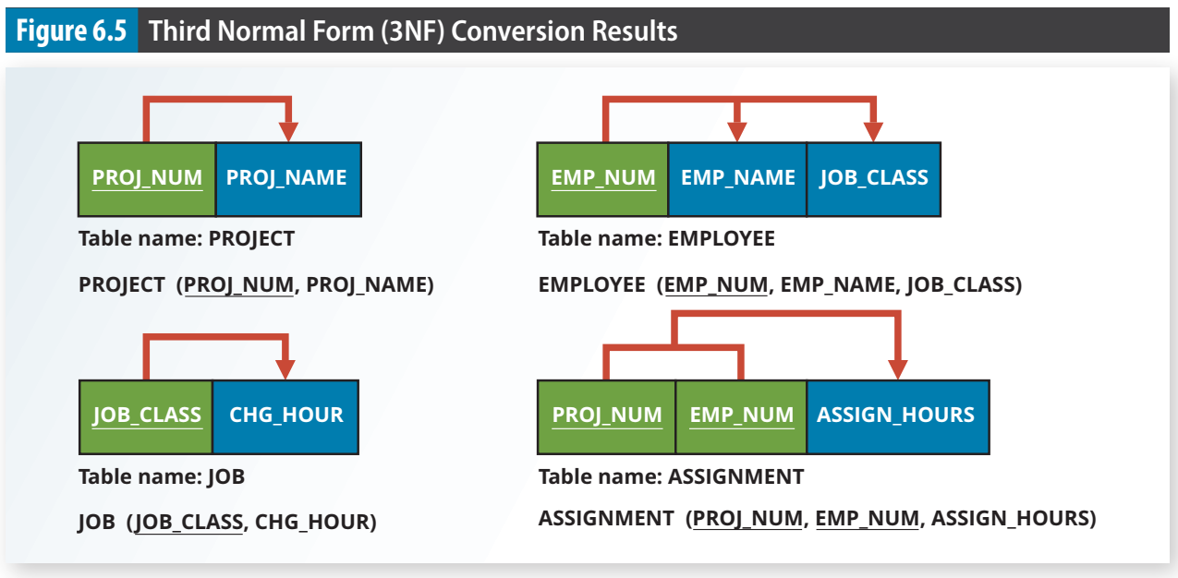

Slide 34
6-6 Higher-Level Normal Forms

Slide 35
6-6a The Boyce-Codd Normal Form
Boyce-Codd normal form (BCNF) A special type of third normal form (3NF) in which every determinant is a candidate key. A table in BCNF must be in 3NF.
A candidate key has the same characteristics as a primary key, but for some reason, it was not chosen to be the primary key
BCNF can be violated only when the table contains more than one candidate key

Slide 36
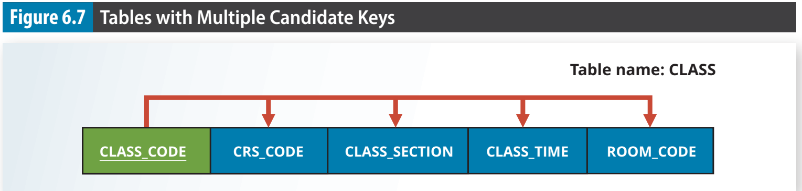
The CLASS table has two candidate keys: • CLASS_CODE • CRS_CODE + CLASS_SECTION

Slide 37
6-6a The Boyce-Codd Normal Form
The table is in 1NF because the key attributes are defined and all nonkey attributes are determined by the key.
The table is in 2NF because it is in 1NF and there are no partial dependencies on either candidate key.
The table is in 3NF because there are no transitive dependencies.
A table be in 3NF and not be in BCNF?
one key attribute is the determinant of another key attribute
because BCNF requires that every determinant in the table be a candidate key

Slide 38
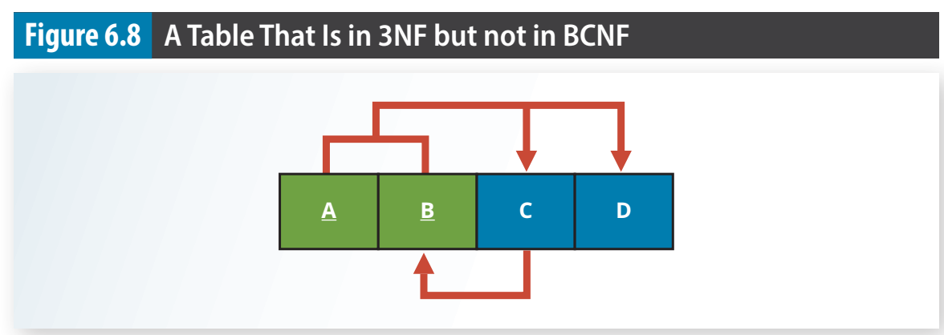
The functional dependencies in Figure 6.8: A + B → C, D A + C → B, D C → B : one key attribute determines part of the primary key
The condition C → B causes the table to fail to meet the BCNF requirements.
An attribute that is a part of a key is called a key attribute

Slide 39
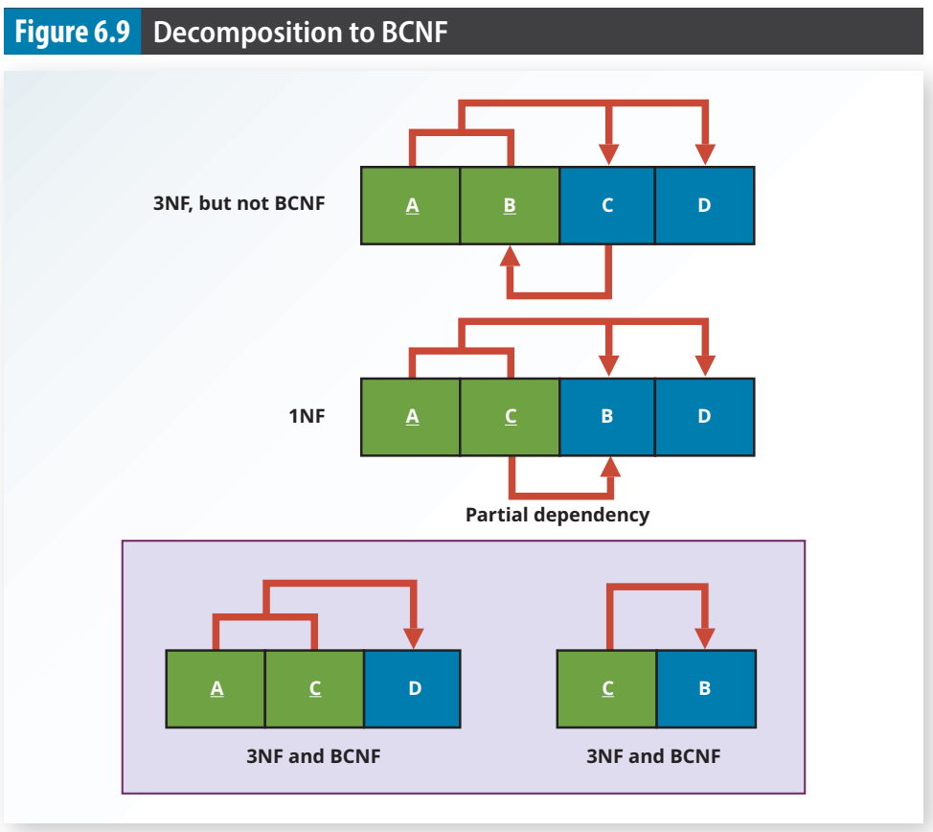

Slide 40
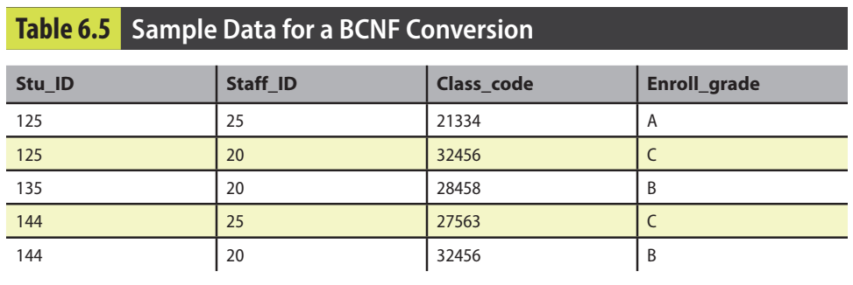
The structure shown in Table 6.5 is reflected in Panel A of Figure 6.10: STU_ID + STAFF_ID → CLASS_CODE, ENROLL_GRADE CLASS_CODE → STAFF_ID

Slide 41
6-6a The Boyce-Codd Normal Form
Each CLASS_CODE identifies a class uniquely
Illustrate the case in which a course might generate many classes.
A student can take many classes.
A staff member can teach many classes, but each class is taught by only one staff member
The structure shown in Table 6.5 is reflected in Panel A of Figure 6.10: STU_ID + STAFF_ID → CLASS_CODE, ENROLL_GRADE CLASS_CODE → STAFF_ID

Slide 42
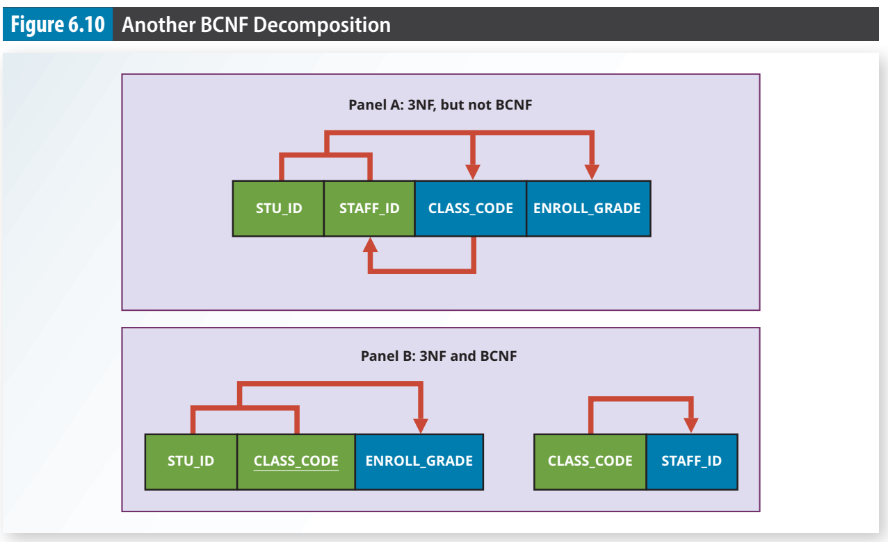

Slide 43
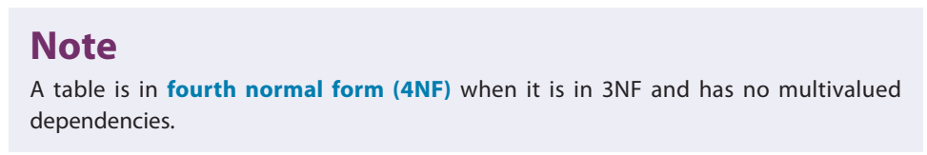
6-6b Fourth Normal Form (4NF)
fourth normal form (4NF) A table is in 4NF if it is in BCNF and contains no multiple independent sets of multivalued dependencies.
Creating new tables for the components of the multivalued dependency.

Slide 44
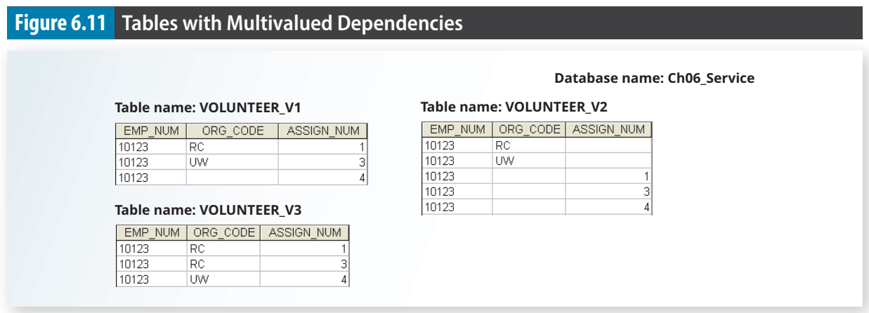
An employee can have multiple assignments and can also be involved in multiple service organizations. Employee 10123 volunteers for the Red Cross and United Way. In addition, the same employee might be assigned to work on three projects: 1, 3, and 4. Figure 6.11 illustrates how that set of facts can be recorded in very different ways.

Slide 45
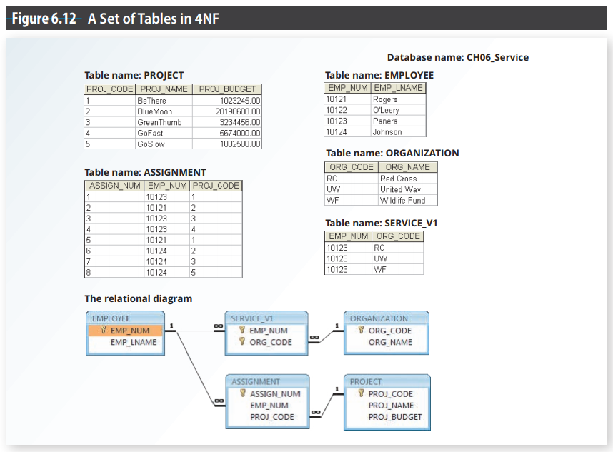

Slide 46
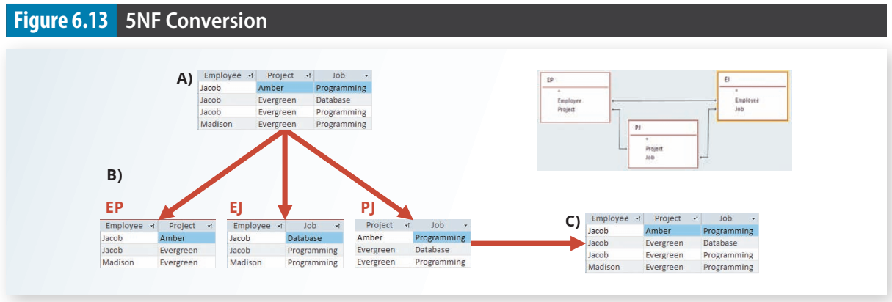
6-6c Fifth Normal Form (5NF)
Fifth normal form, also known as project join normal form (PJNF), addresses the issue in which a table cannot be decomposed anymore without losing data or creating incorrect information
project join normal form (PJNF) Another term for fifth normal form (5NF). A state in which a table is already in 4NF and has no lossless decompositions

Slide 47
6-7 Normalization and Database Design

Slide 48
6-7 Normalization and Database Design
Normalization should be part of the design process.
Make sure that proposed entities meet the required normal form before the table structures are created
Second, normalization focuses on the characteristics of specific entities; that is, normalization represents a micro view of the entities within the ERD

Slide 49
Operations of the contracting company
The company manages many projects.
Each project requires the services of many employees.
An employee may be assigned to several different projects.
Some employees are not assigned to a project and perform duties not specifically related to a project. Some employees are part of a labor pool, to be shared by all project teams. For example, the company’s executive secretary would not be assigned to any one particular project.
Each employee has a single primary job classification, which determines the hourly billing rate.
Many employees can have the same job classification. For example, the company employs more than one electrical engineer.

Slide 50
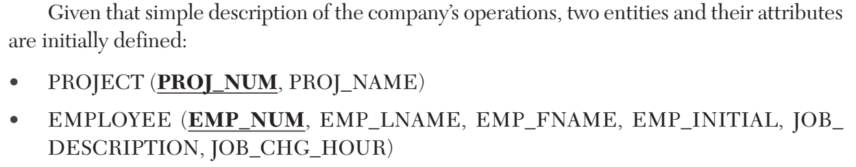

Slide 51
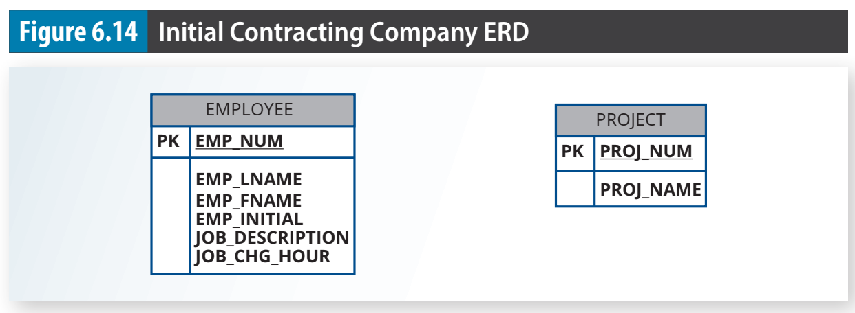

Slide 52
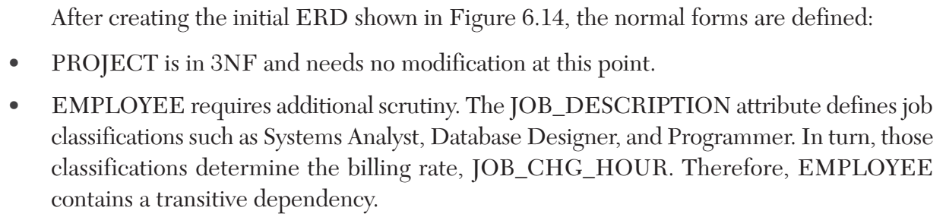

Slide 53
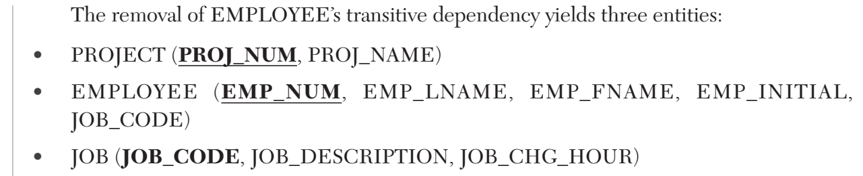

Slide 54
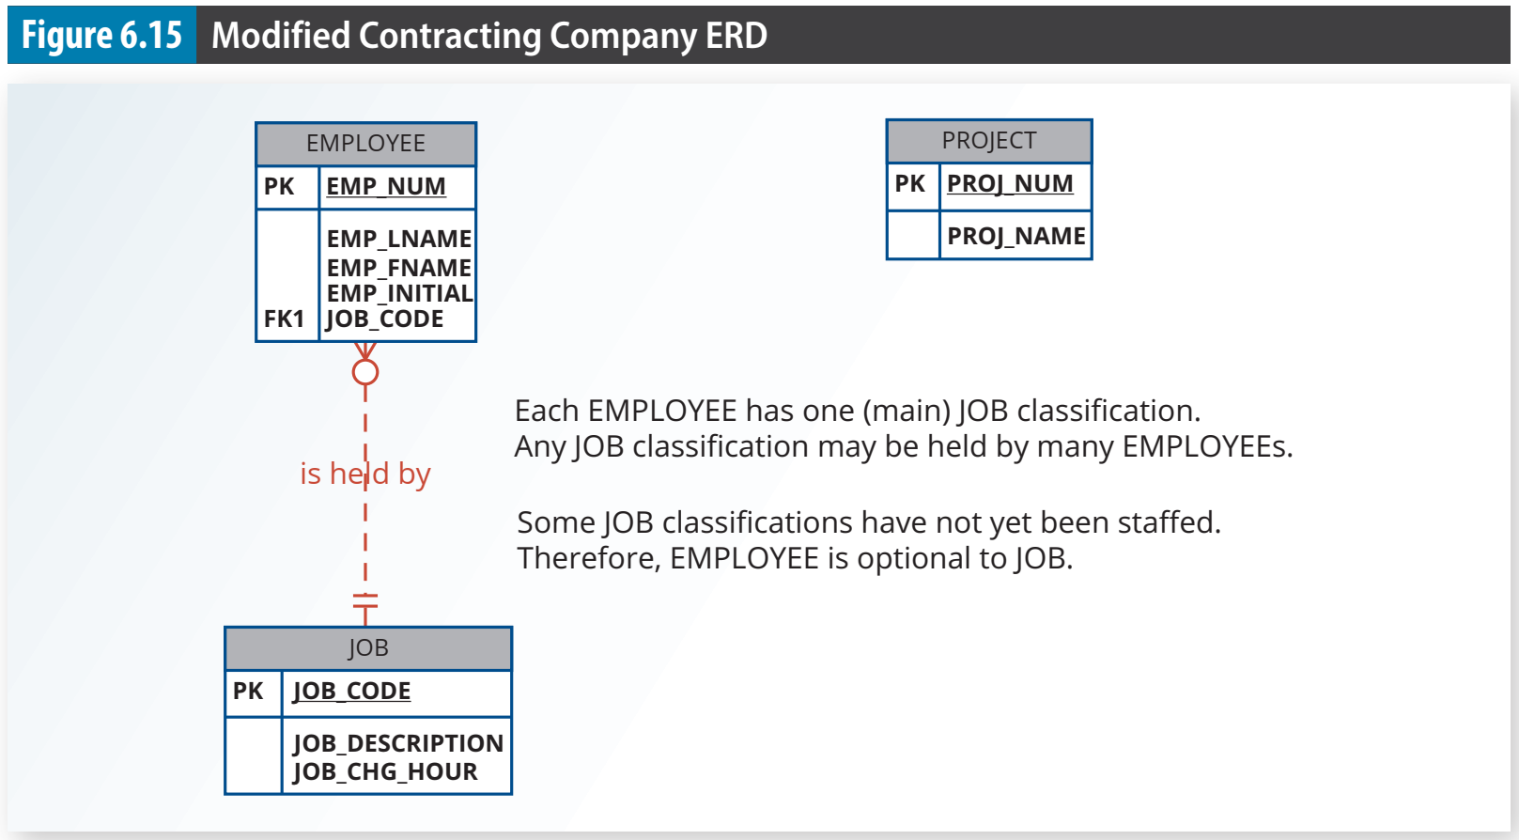

Slide 55
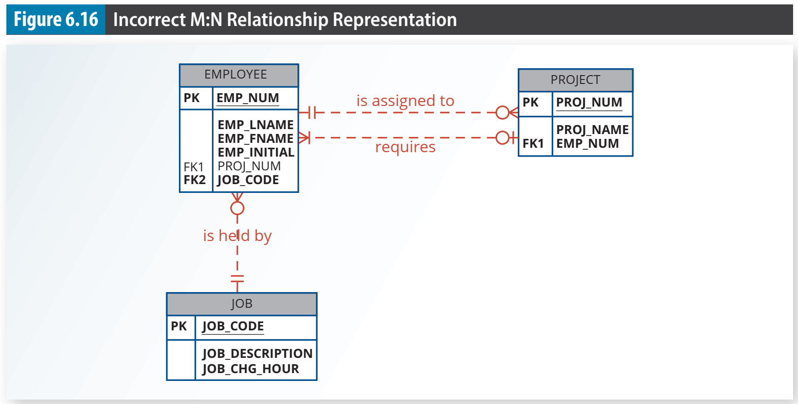

Slide 56
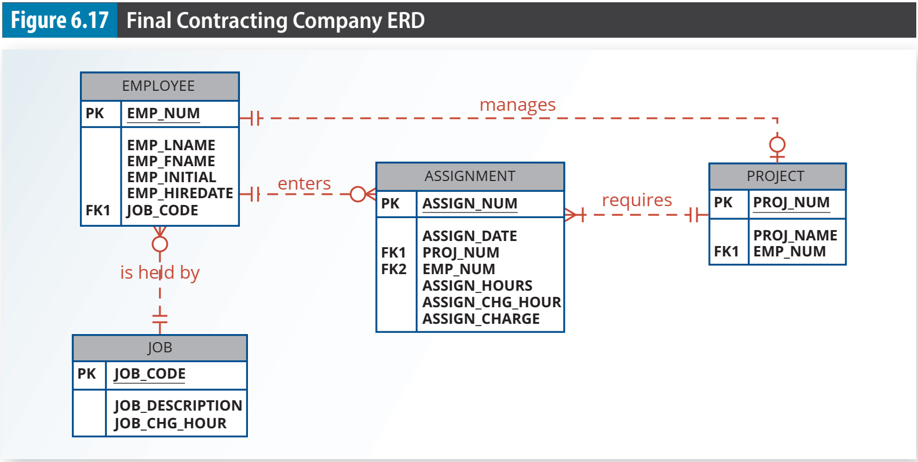

Slide 57
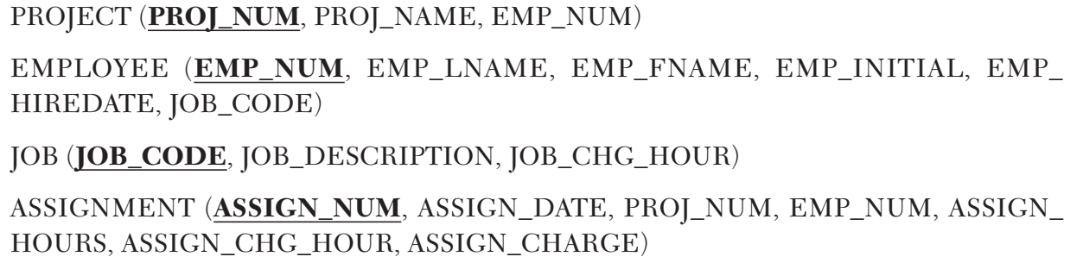

Slide 58
6-8 Denormalization

Slide 59
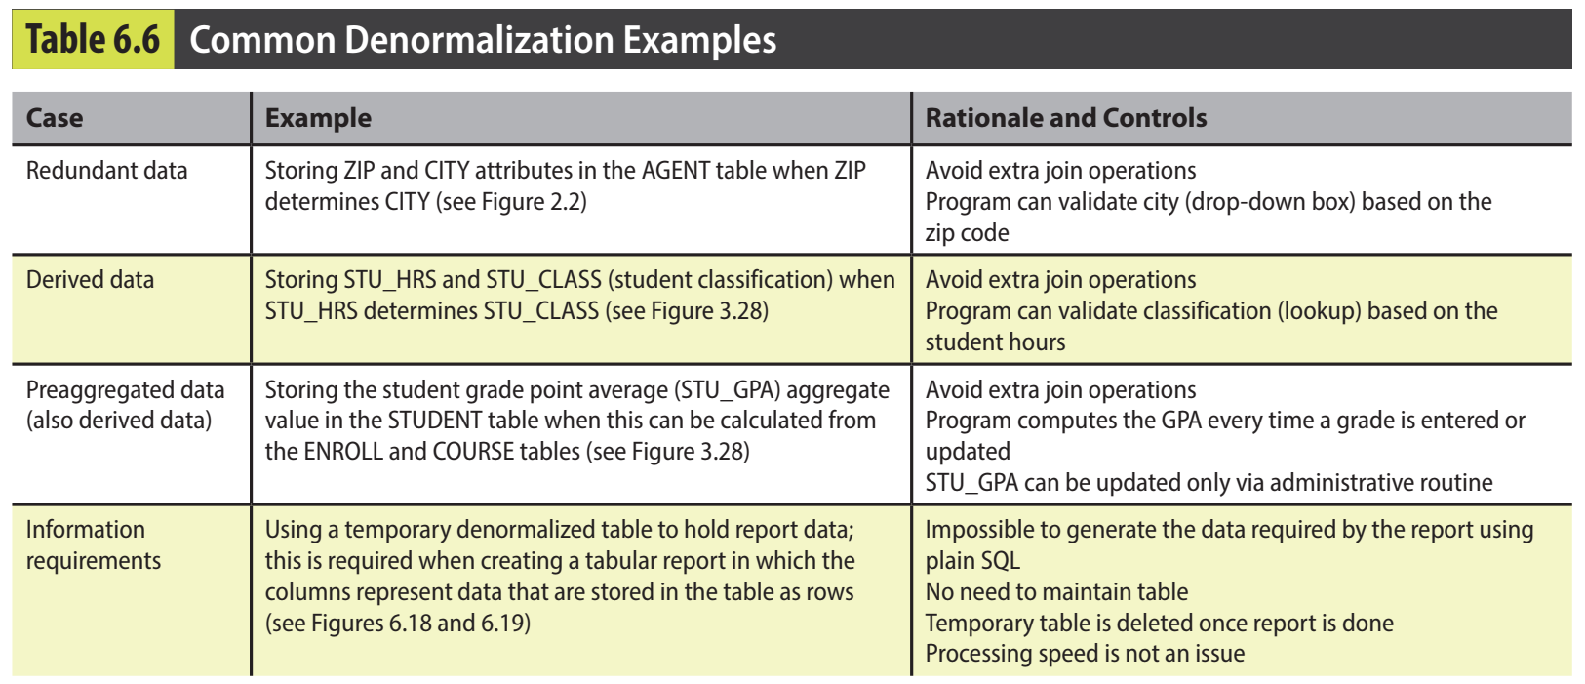

Slide 60
6-9 Data-Modeling Checklist

Slide 61
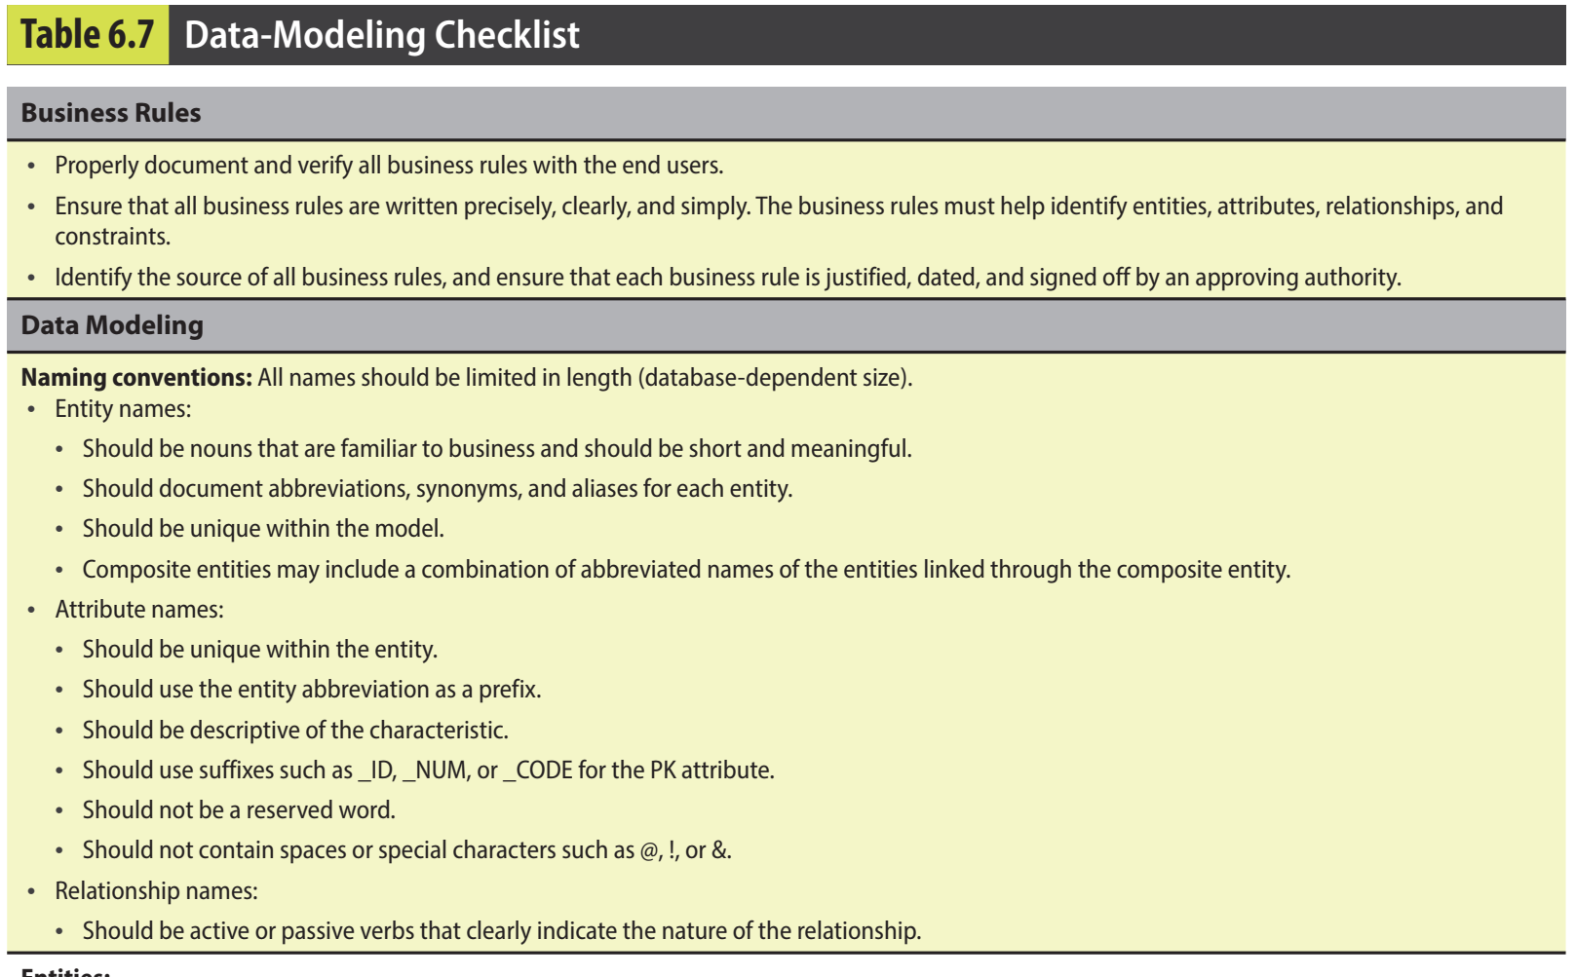

Slide 62
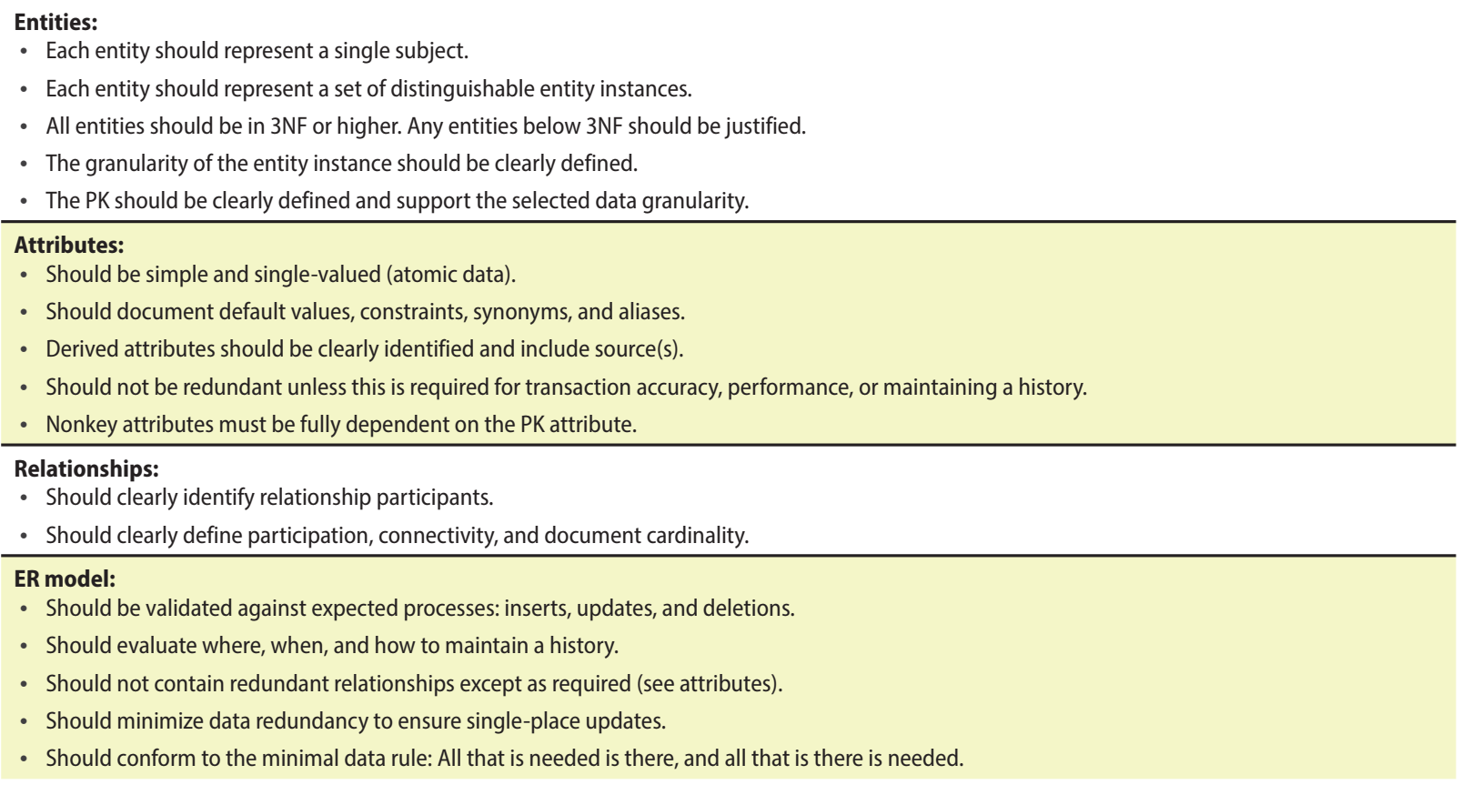

Slide 63
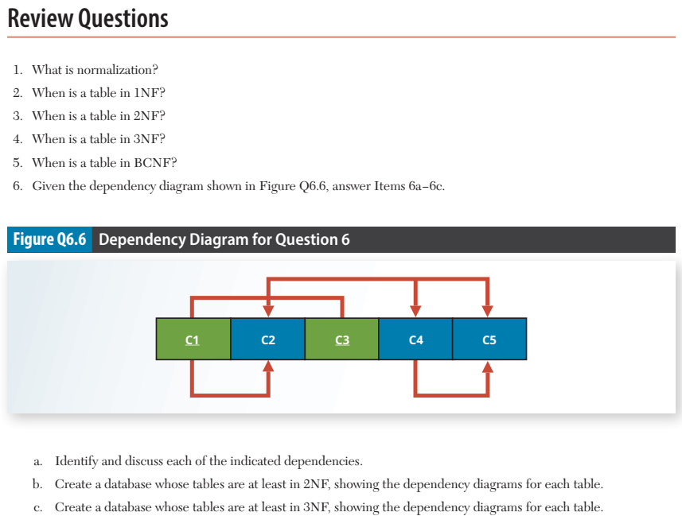

Slide 64
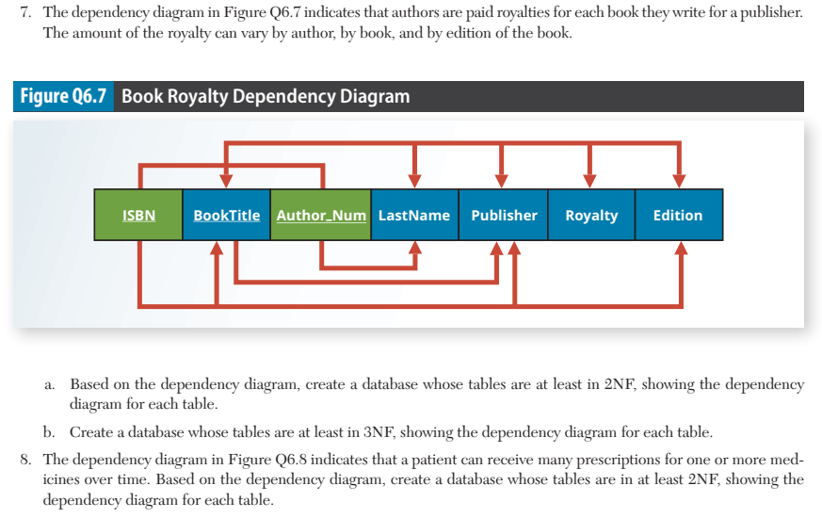

Slide 65
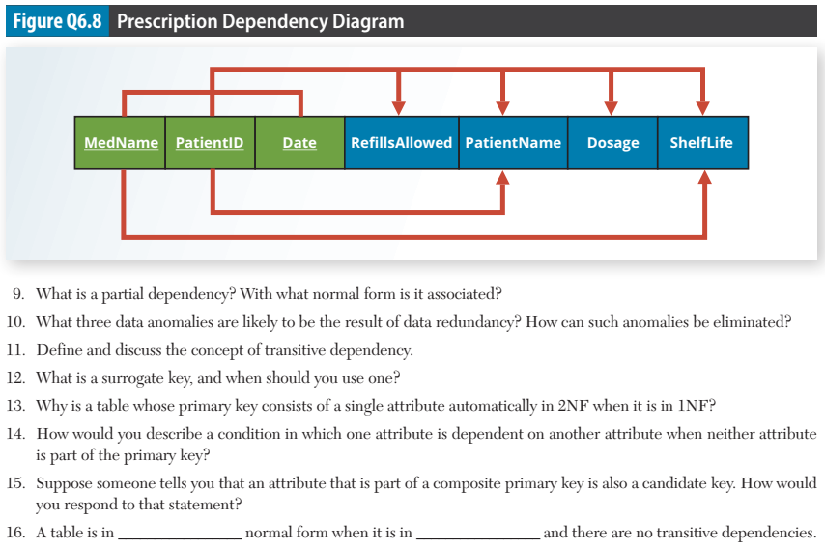

Slide 66
Problems

Slide 67
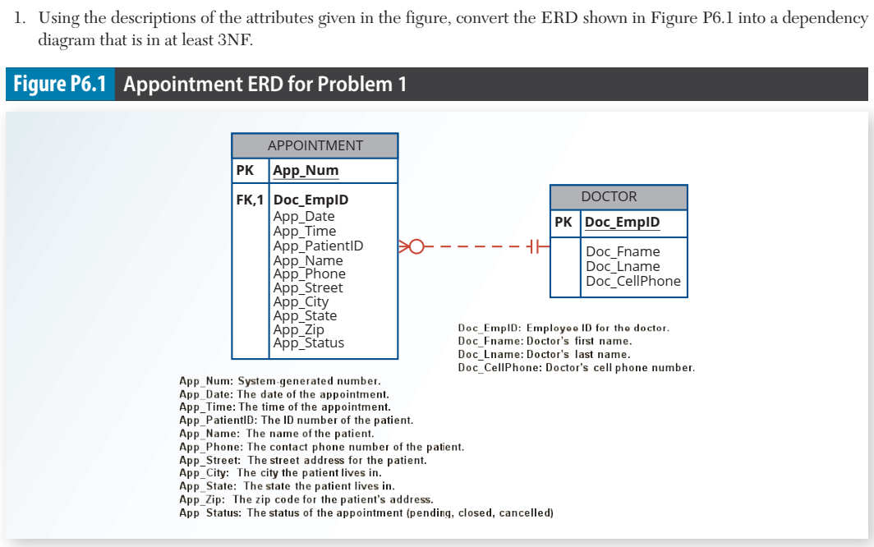

Slide 68
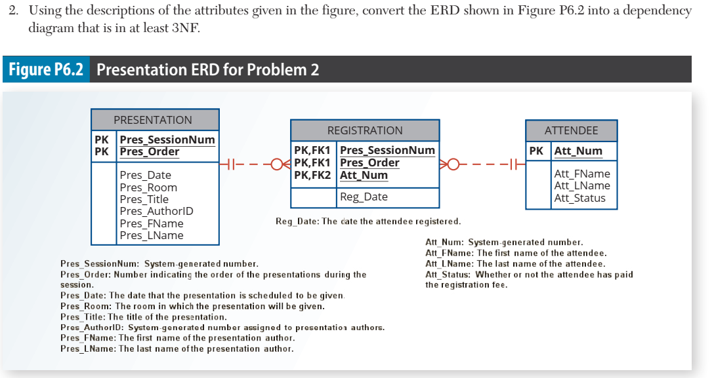

Slide 69
